Slide 1

Math weeks!
A little pep talk! Don’t be afraid! <3

Slide 2
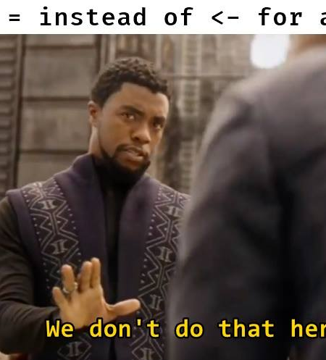
Small exercise from last week!
- Let’s go into R studio and have a look at how to code different types of randomization.
- In your papers you should always specify how you’ve randomized (if you randomize) the conditions or participants.
- Also, a nice way of getting used to working with functions

Slide 3
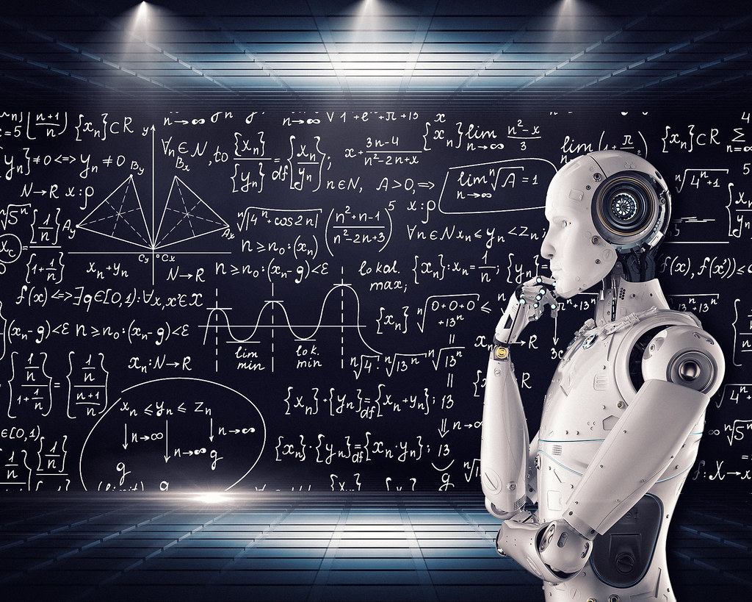
Disclaimer
You didn’t choose math… math chose you.
I am just a lowly AI and Neuroscience guy.
No math expert but it is fun.
Before it gets fun, we need the basics.
But why???
I just want to do cognitive science?
What does math have to do with it.

Slide 4

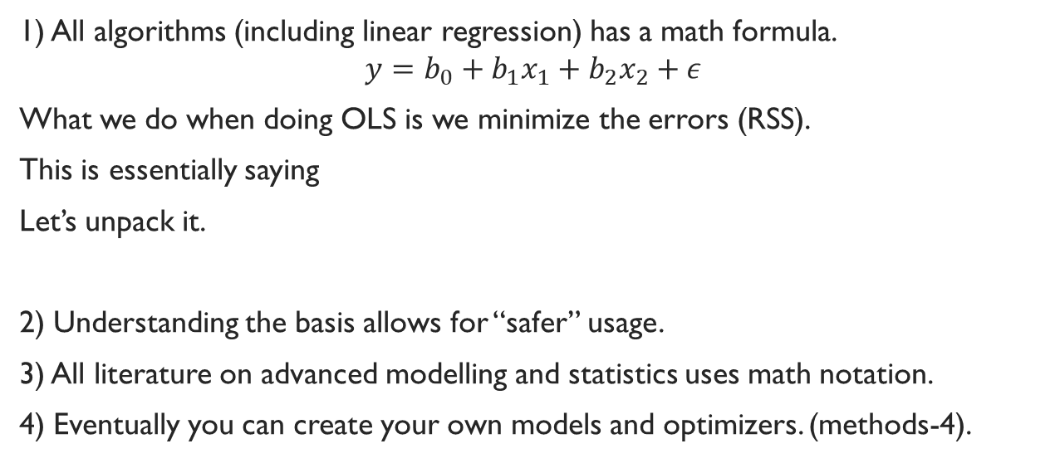
The Why?
1) All algorithms (including linear regression) has a math formula.
$$y=b_{0}+b_{1}x_{1}+b_{2}x_{2}+ε$$
What we do when doing OLS is we minimize the errors (RSS).
This is essentially saying
Let’s unpack it.
2) Understanding the basis allows for “safer” usage.
3) All literature on advanced modelling and statistics uses math notation.
4) Eventually you can create your own models and optimizers. (methods-4).

Slide 5
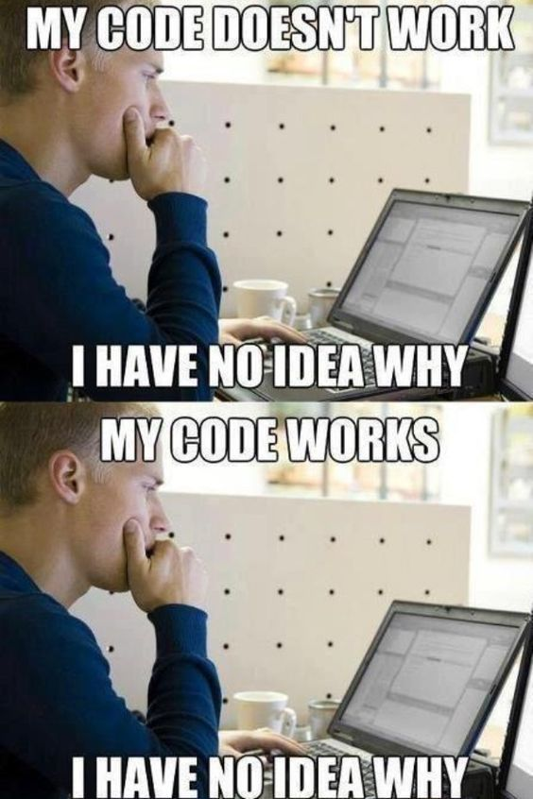
Our plan:
We need the basics!
May seem redundant now but will make A LOT of sense in the coming semesters.
Principal-Component - eigen-values.
Optimizers - argmin() argmax().
Derivatives for machine learning optimizers (Gradient Decent) (Boosted gradient decent) among others.
Algebraic solutions to OLS using matrix multiplication (later this semester).

Slide 6
Today
Math notation and latex.
Without this you’re doomed.
So, exercises on this and we sum it up in the class together.
2. Set calculation (in .Rmd)
3. Exercises from chapter 1, (in hand/.Rmd no computer solvers allowed)

